Slide 1
Today
In Python,
Little CGI
Big CGI

Slide 2
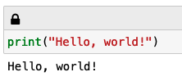
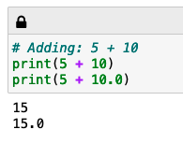
Little CGI: Printing things & using Python as a calculator
Just printing some text
Printing the result of a calculation

Slide 3
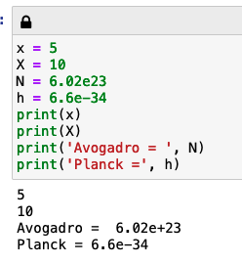
Little CGI: Storing data as named variables
Upper/lower case matters!
Entering numbers in “E-format”
We can print multiple things together

Slide 4
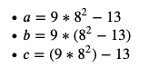
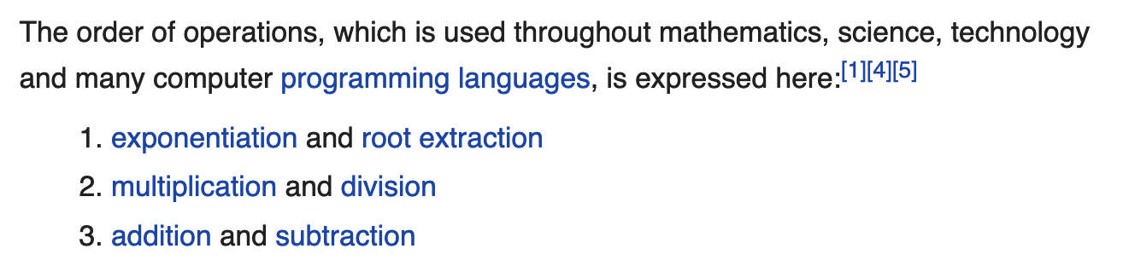
Little CGI: Order of operations
Which one of these is different from the others?
https://en.wikipedia.org/wiki/Order_of_operations says …

Slide 5
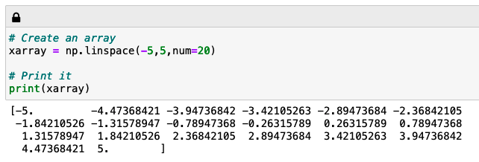
Little CGI: Scalars vs arrays, and making arrays from other arrays
A scalar is just a single number, an array is a bunch of scalars
Numpy’s linspace function makes array-making easy
20 numbers in “xarray”

Slide 6
Little CGI: Scalars vs arrays, and making arrays from other arrays
A variable calculated using an array is usually another array of the same length
20 numbers in “xarray”
20 numbers in “xsquared” and “rootx” too

Slide 7
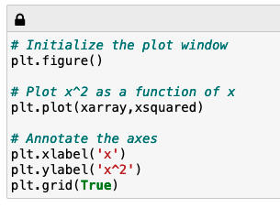
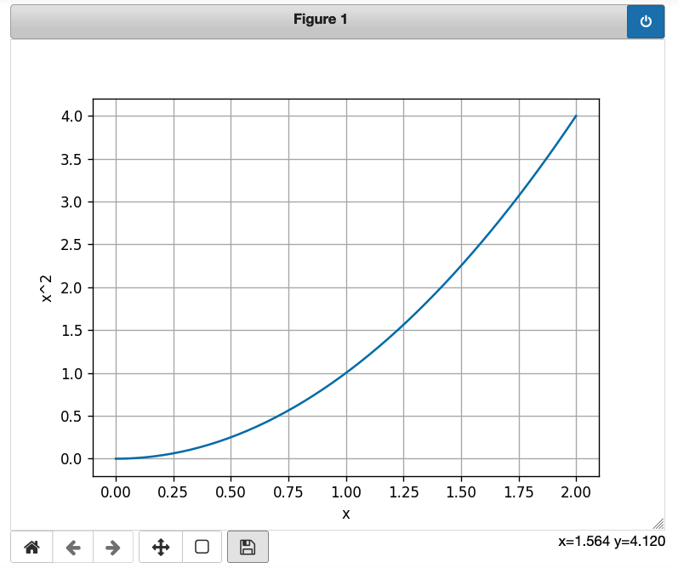
Little CGI: Graphing
Use these to pan, zoom, and save!

Slide 8
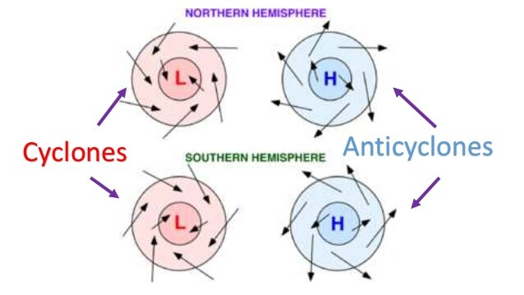
Big CGI: Exploring a correlation
Hypothesis: Lower pressure at the center of a cyclonic synoptic system => faster winds around the center.
Earth.nullschool.net + Python will let you explore whether that’s true!
https://revision.co.zw/cyclones/

Slide 9
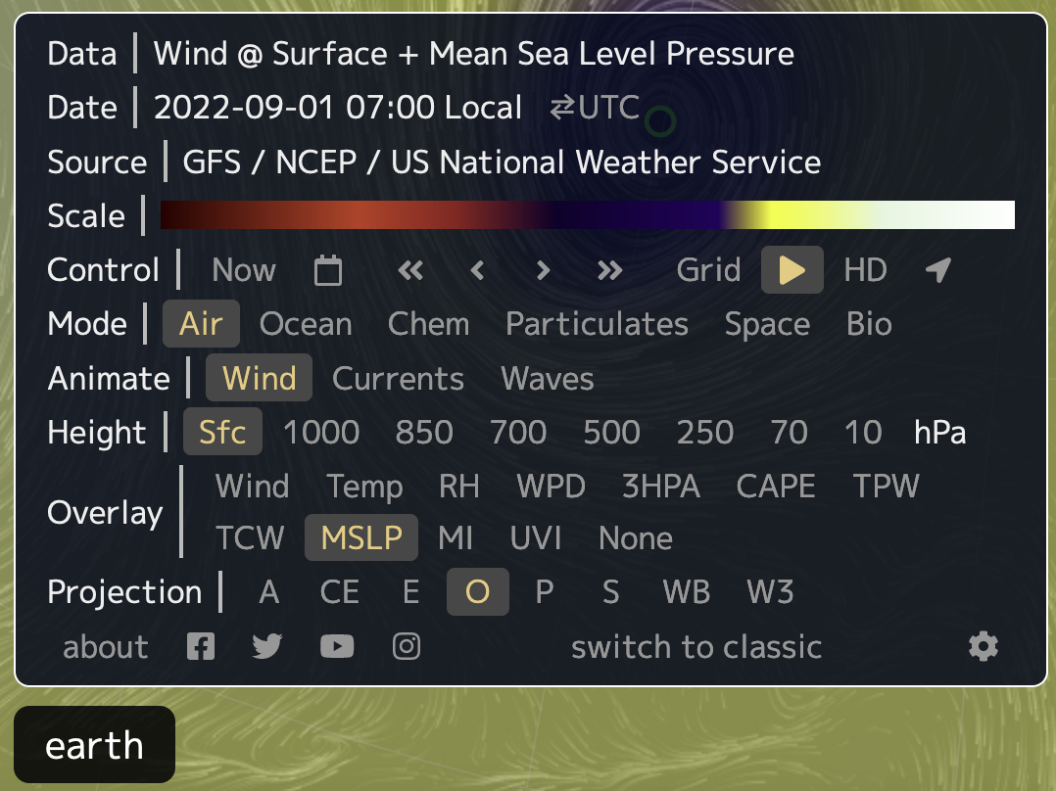
Big CGI: Exploring a correlation

Slide 10
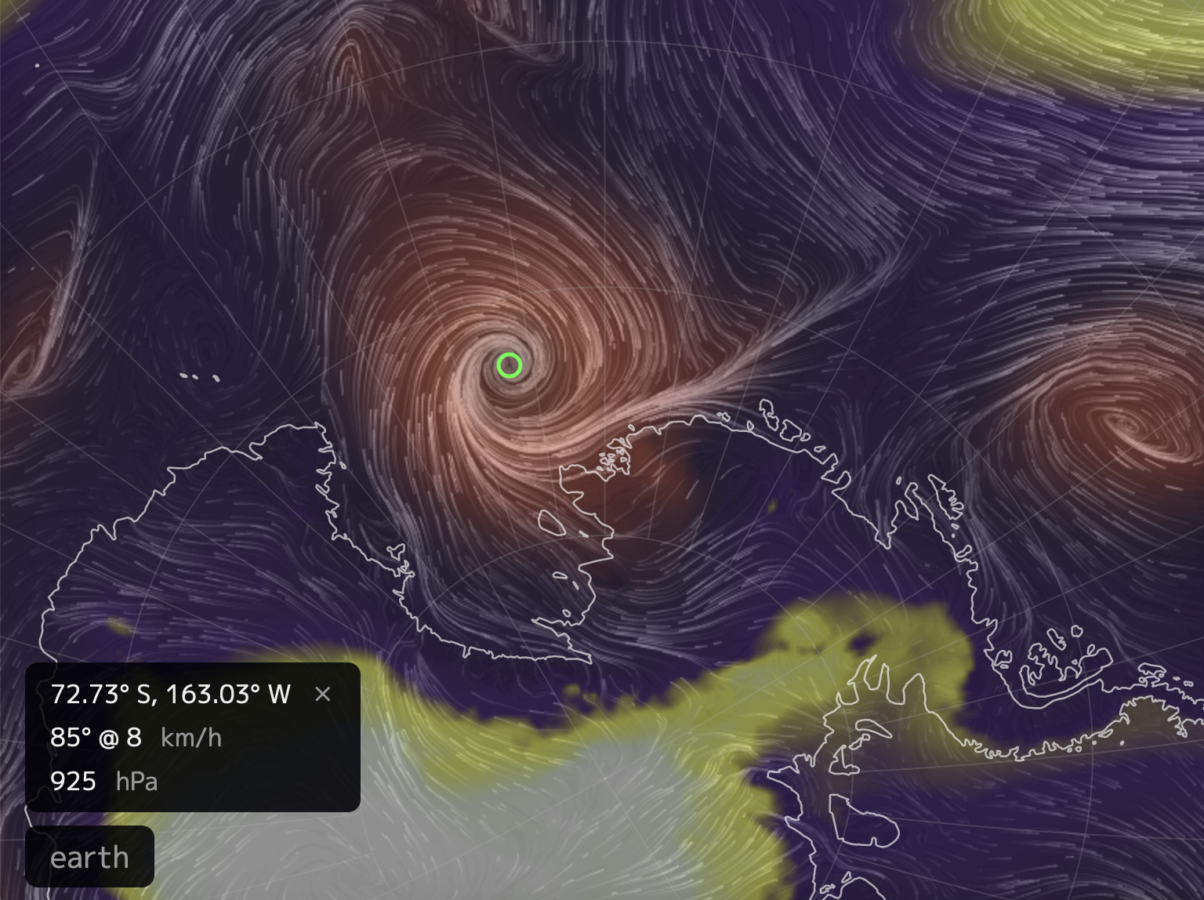
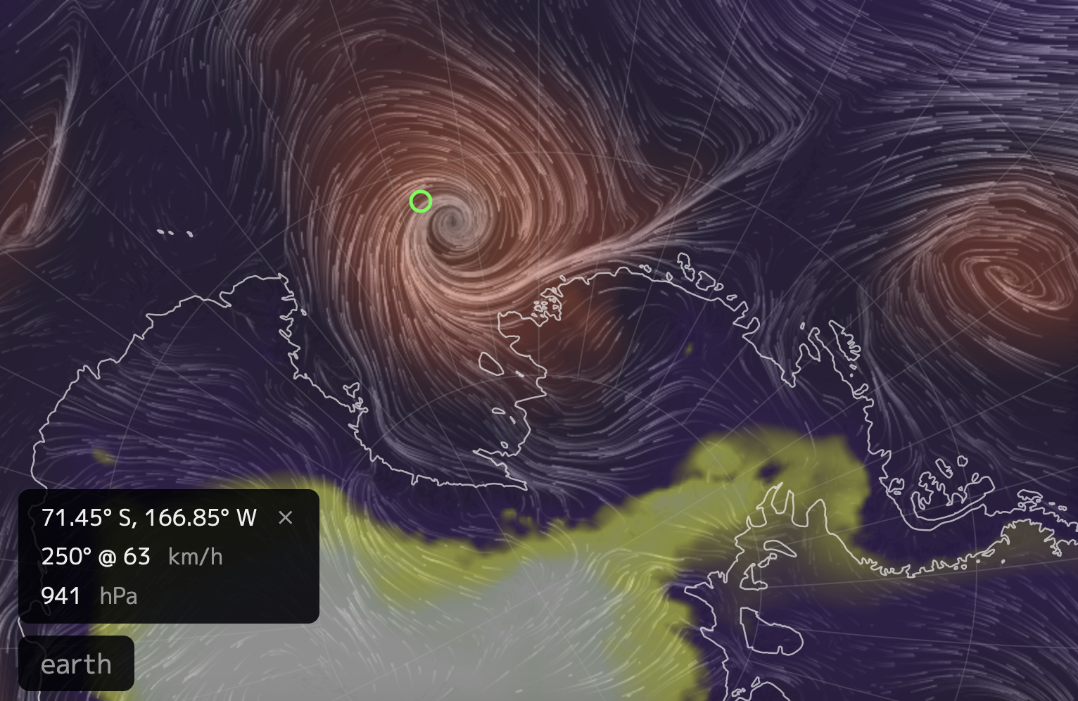
Big CGI: Exploring a correlation
Pressure at the center of the cell
Maximum wind speed somewhere around the cell

Slide 11
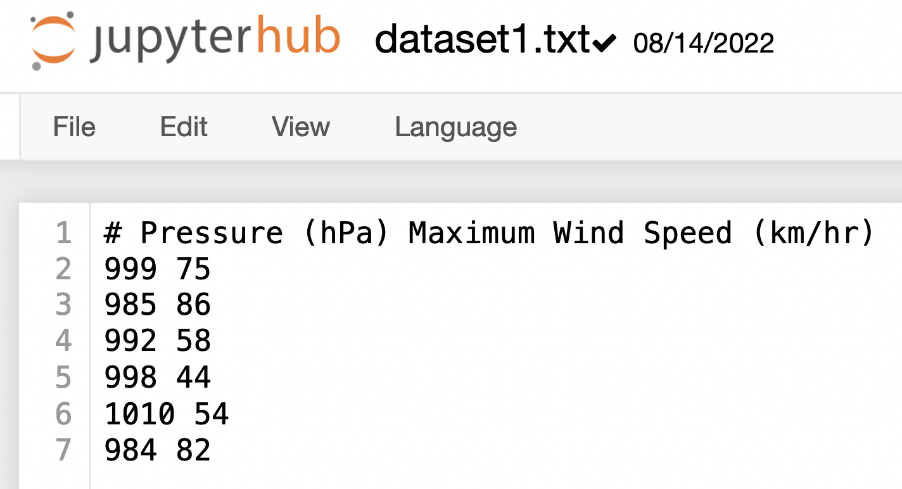
Big CGI: Exploring a correlation
Here are some sample data in the file dataset1.txt

Slide 12
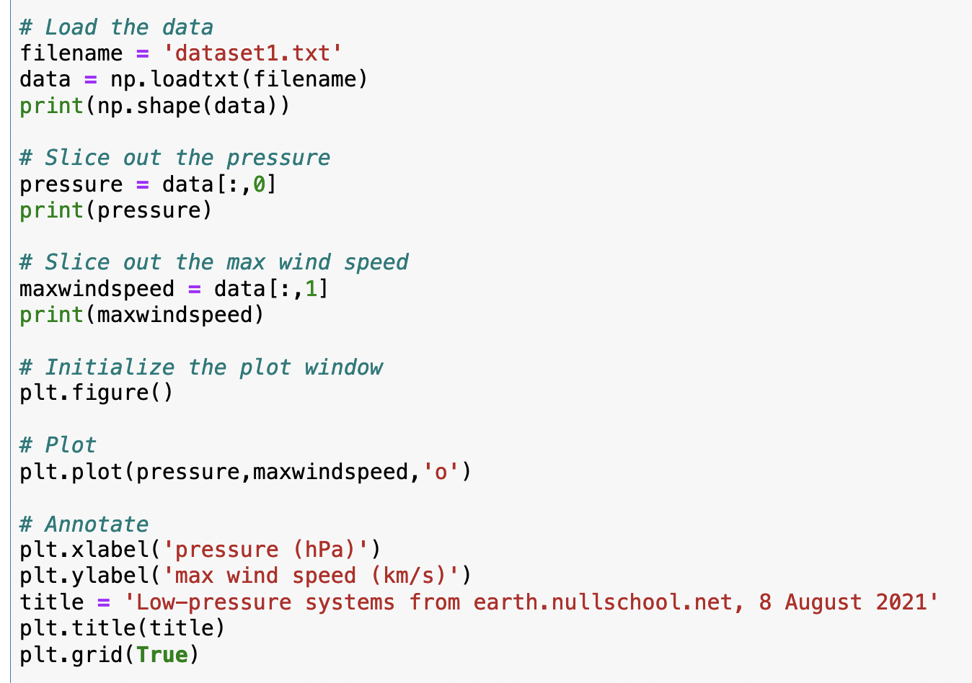
Big CGI: Exploring a correlation
Here’s how loading works

Slide 13
Big CGI: Exploring a correlation
And here’s how slicing works

Slide 14
Big CGI: Exploring a correlation
And here’s how slicing works

Slide 15
Big CGI: Exploring a correlation
And here’s how slicing works

Slide 16
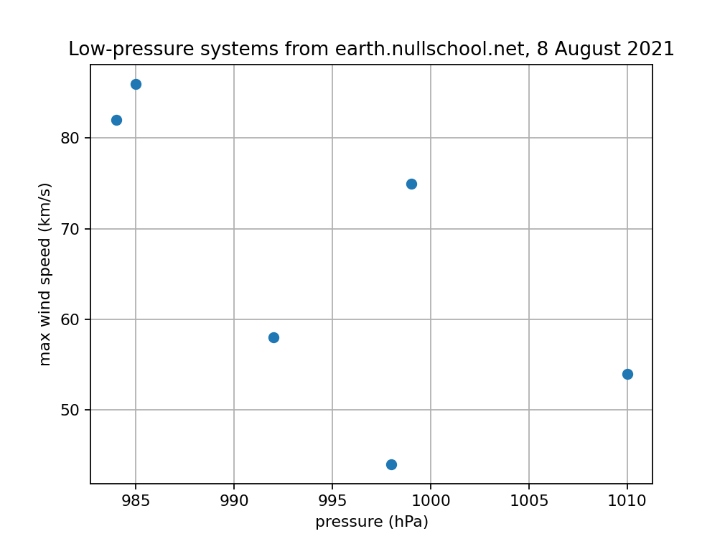
Big CGI: Exploring a correlation
And here’s what the data look like as a scatter plot

Slide 17
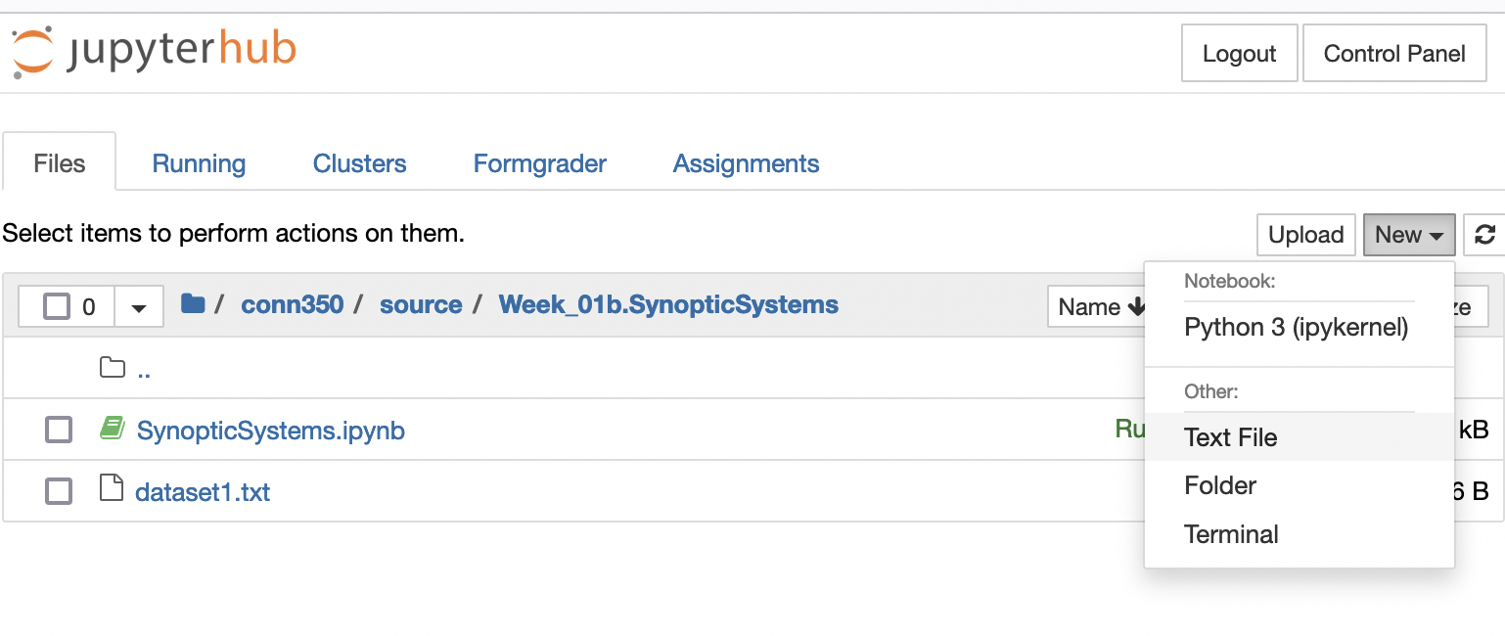
Big CGI: Exploring a correlation
You’ll put your data in dataset2.txt

Slide 18
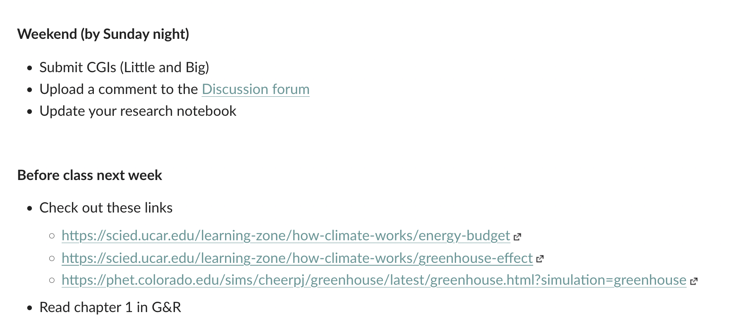
Next week
Also, if you haven’t done it already, please send me a link to your research notebook (a Google Slide document).

